Slide 1


NATURAL LANGUAGE PROCESSING
M.FURQAN AHMAD
FA19-BST-002

Slide 2

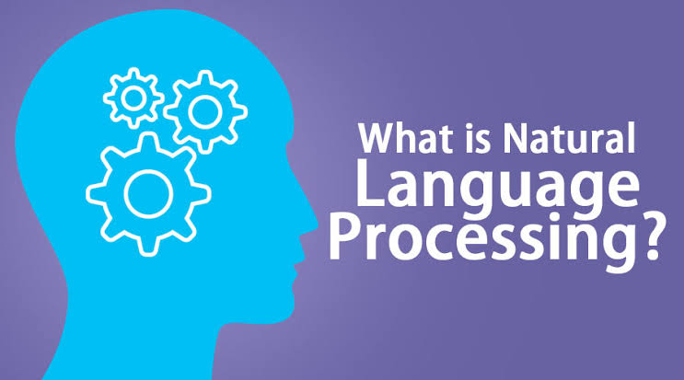
WHAT IS NLP ?

Slide 3

NLP
COMMUNICATE
REPLICATE

Slide 4
APPLICATIONS
?

Slide 5





SENTIMENTAL ANALYSIS
CHATBOTS
01
03
SPEECH RECOGNITION
MACHINE TRANSLATION
02
04

Slide 6




SPELL CHECKING
KEYWORD SEARCHING
5
6
INFORMATION EXTRACTION
ADVERTISEMENT MATCHING
7
8

Slide 7

COMPONENTS
NATURAL LANGUAGE UNDERSTANDING
NATURAL LANGUAGE GENERATION

Slide 8
TOKENIZATION
STEMMING
1
2
LEMMATIZATION
POS TAGS
3
4
STEPS

Slide 9
5
NAMED ENTITY RECOGNITION
6
CHUNKING

Slide 10
TOKENIZATION
TOKENIZATION is the first step step in NLP

Slide 11
STEMMING
Normalize words into base form or root form

Slide 12
AFFECT
AFFECTATION
1
2
AFFECTS
AFFECTIONS
3
4
AFFECTED

Slide 13
LEMMATIZATION
It takes into consideration the more logical concept of the word

Slide 14
LEMMATIZATION
Group together different inflected forms of a word, called Lema
1
2
It maps simmilar words into one common root
Output is a proper word
3
4
Gone, went and going into go

Slide 15
POS TAGS
Adverb
Verb
INTERJECTION
Adjective
Pronoun
Noun

Slide 16
NAMED ENTITY RECOGNITION

Slide 17
CHUNKS
6
Picking up individual pieces of information and grouping them into bigger pieces

Slide 18
CHUNKING
We | Caught | the | Panther
Preposition | Verb | Article | Noun

Slide 19



NLTK

Slide 20



Slide 21
THANKS

